Slide 1
Test Data Management
Pravin Y Pawar
Adapted from
KPMG Test data management challenges

Slide 2
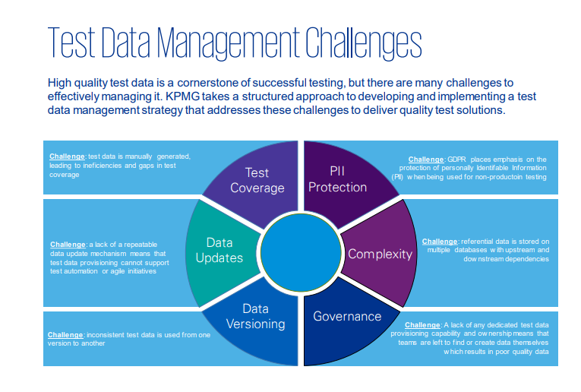
Test Data Management
Challenges

Slide 3
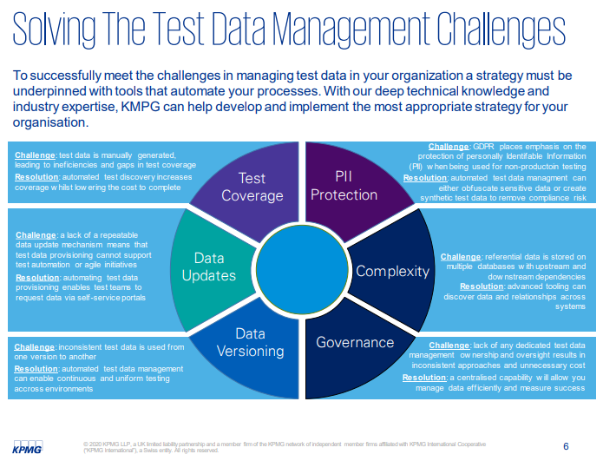
Test Data Management
Resolution

Slide 4
Thank You!
In our next session:

